Slide 1

WEB SCRAPING TO GAIN COMPANY INSIGHTS

Slide 2
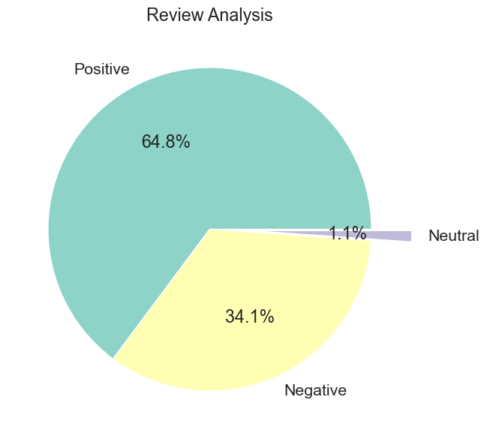
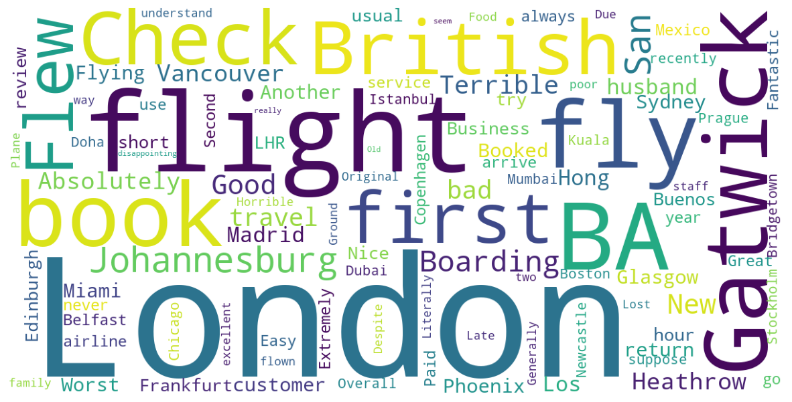
INSIGHTS FROM CUSTOMER REVIEWS
Cleaning 1000 customer reviews, we have drawn the following insights
Positive reviews – 648
Negative reviews – 341
Neutral Reviews – 11
Most common negative reviews included words like:
Delayed, cancelled, refund
Service, food, time, terrible
Most common positive reviews included:
Business class, lounge, comfortable
Friendly, seat, good

